Slide 1
Welcome to Project Presentation
Title : Online Election Management System.
Presented by :
Redwan Ahmed Adil
Supervised by :
Shantanu Roy
Junior Instructor
Sylhet Polytechnic Institute.

Slide 2
INTRODUCTION
a) Identifying seven (7) Principal Business Areas (PBAs) that could
remarkably and positively affect the planning, conduct and outcome of
the 2015 General Elections. These are (i) Election Day Logistics (EDL); (ii)
Election Staff Management (ESM); (iii) Political Party and Candidate
Management (PPM); (iv) Election Day Training (EDT); (v) Election Day
Procurement (EDP); (vi) Co.
  b) Identifying, mapping, and sequencing of Election Day processes. Over 192 High Level and hundreds of Lower Level activities were identified, mapped and sequenced. In addition, the owners of these
The prescription software offers doctors a powerful tool for safely and efficiently managing their patient's medications. Compared to paper-based prescribing, the prescription software can enhance patient safety and medication compliance, improve prescribing accuracy and efficiency, and reduce health care costs.

Slide 3
OBJECTIVES
To build a Prescription Management System using PHP (Object Oriented Programming).
Use graphics and MySQL works in the system.
Store data in the MySQL server using xampp.
Easily data Retrieve, Insert, Edit & Delete of the System.
User friendly System, preferable to traditional system.
To solve the problems related to storing information about patients and physician properly.
Keeping records of patients’ info.

Slide 4
Tools used for this project
PHP
CSS
HTML
Mysql
Xammp control panel

Slide 5
METHODOLOGY
Study design: This was a cross-sectional comparative study.
Place of study: Dept. of Computer Science and Engineering
Sylhet Polytechnic Institute, Sylhet
Period of study: During the period from 1st December 2015 to 30th May 2016.

Slide 6
METHODOLOGY
The following section describes the design methodology that we choose for the implementation of the system. The focus of the project will be on a clear understanding of the problem domain, clear activities and correctness. For these reasons we have chosen to implement the project using Waterfall model.

Slide 7
Waterfall Model
Requirements definition
System& software design
Implementation & unit testing
Integration & system testing
Operations & maintenance
For these reasons we have chosen to implement the project using Waterfall model.

Slide 8
Cont.
Requirements analysis and definition: The system’s constraints and goals are established by consultation with the system users.
Implementation and unit testing: During this stage, the software design is realized as a set of programs. Unit testing involves verifying that each unit meets its specifications.
System and software design: The system design process partitions the requirements to either hardware or software systems. It establishes overall system architecture.
Integration and system testing: System testing verifies that the system design has been implemented correctly and acceptance testing validates the requirements analysis.
Operation and maintenance: In this stage, the system is installed and put into practical use. Maintenance involves correcting errors, which were not discovered in earlier stages.

Slide 9
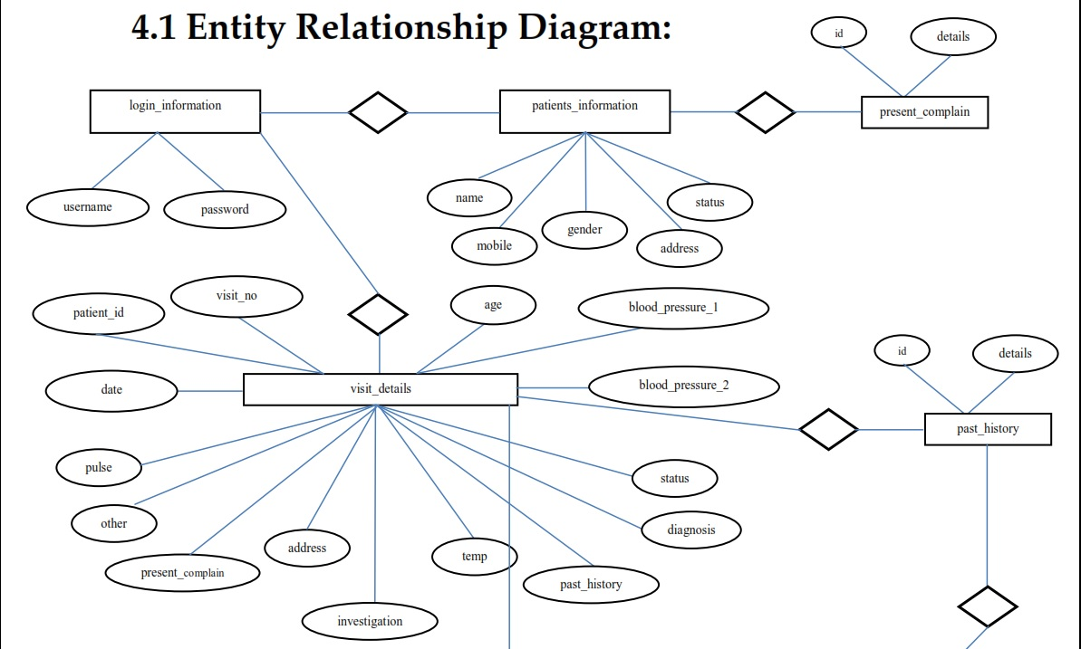
E-R Diagram

Slide 10
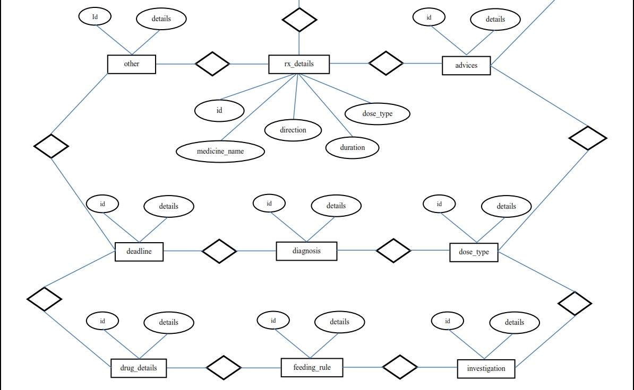
E-R Diagram cont.

Slide 11
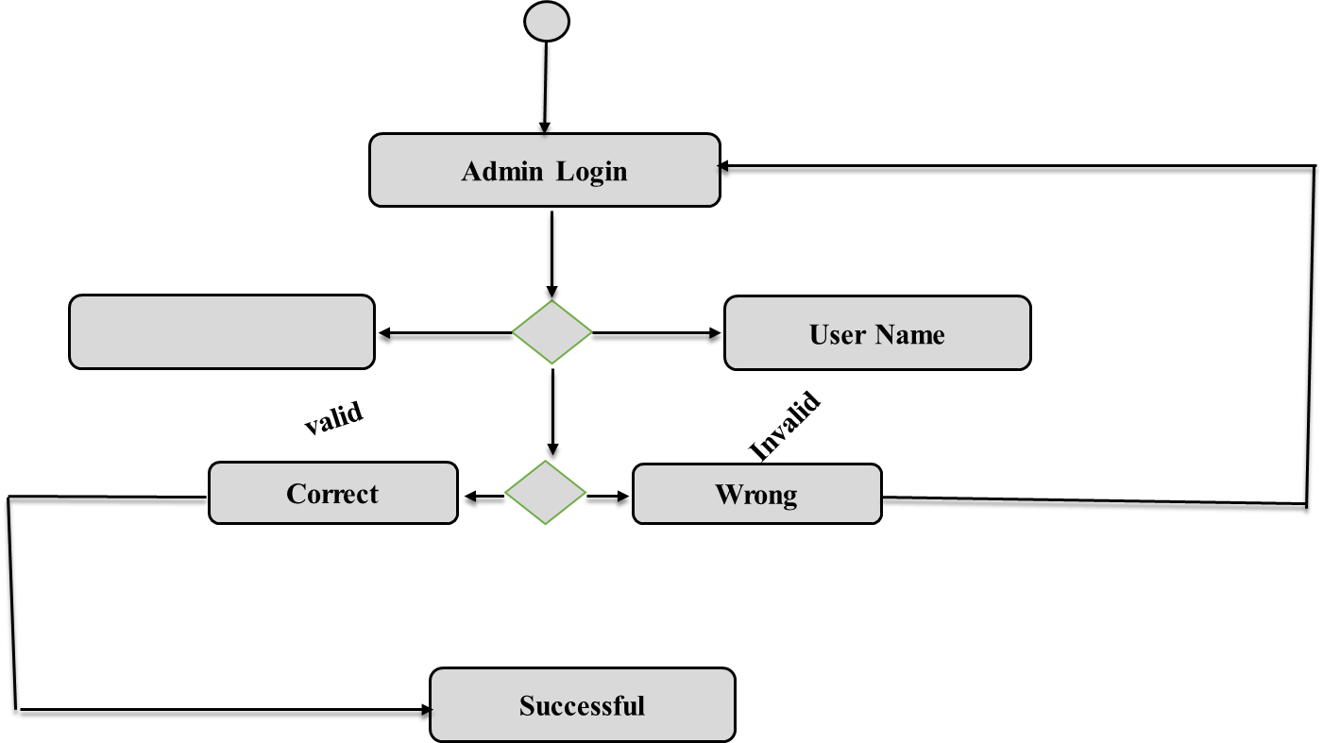
Use Case Diagram
Password

Slide 12
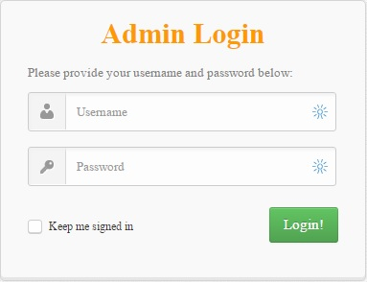
Project Snapshots

Slide 13
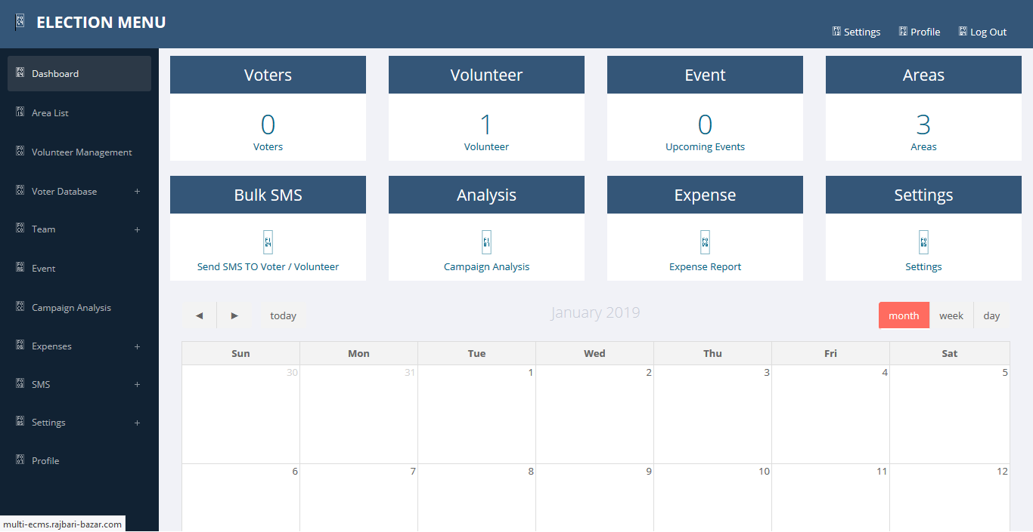
Project Snapshots

Slide 14
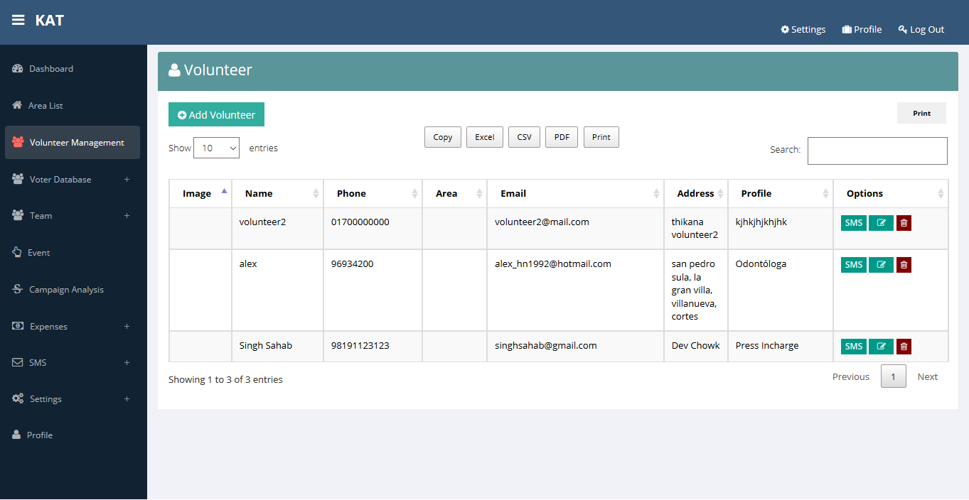
Project Snapshots

Slide 15
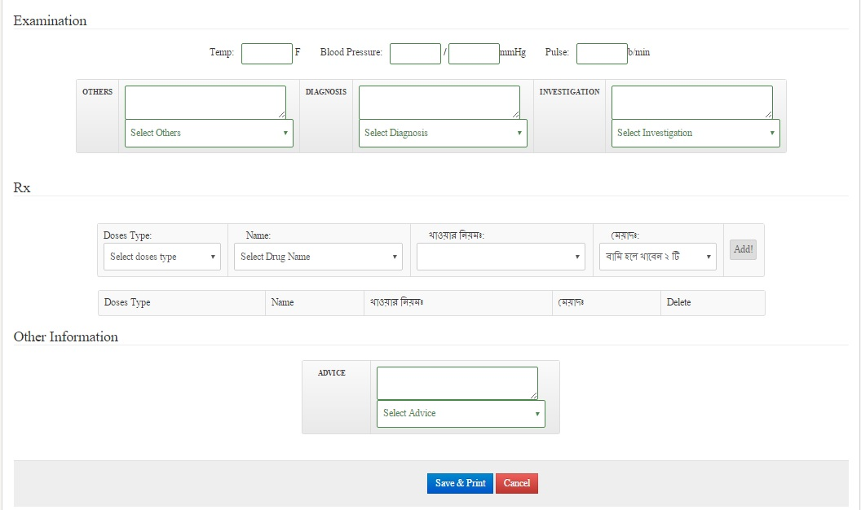
Project Snapshots

Slide 16
System Testing and Debugging
Function Testing
Performance Testing
Black-box testing
White-box testing
Alpha testing
Beta testing

Slide 17
Limitations
Financial Cost and Return on Investment (ROI)
Change Management
Erroneous alerts
Integrity of data input
Future Plan
In future we wish to make it responsive for mobile apps, tablet PC. Other options are added, it depends on customer satisfaction.

Slide 18


